Slide 1
Pre Ph.D. Course Work (Common Compulsory Course – II) Dr Sarita Pandey Assistant Professor of English Jananayak Chandrashekhar University, Ballia, U.P., India
Notes:
Line spacing + Page numbers

Slide 2
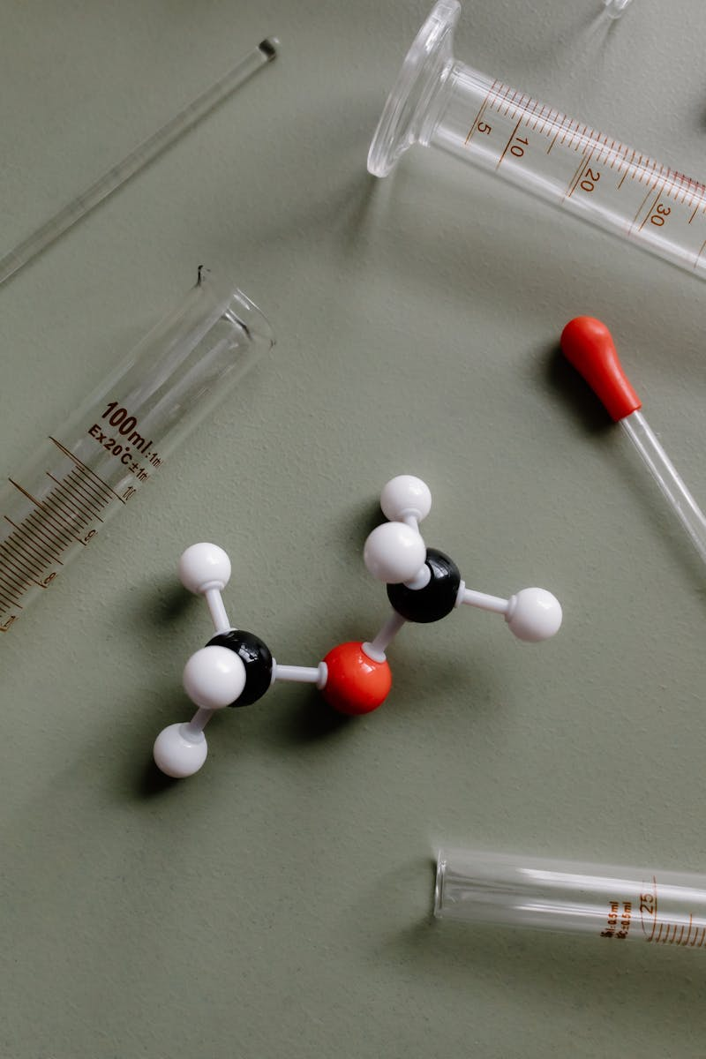
Scientific Conduct & Misconduct

Slide 3
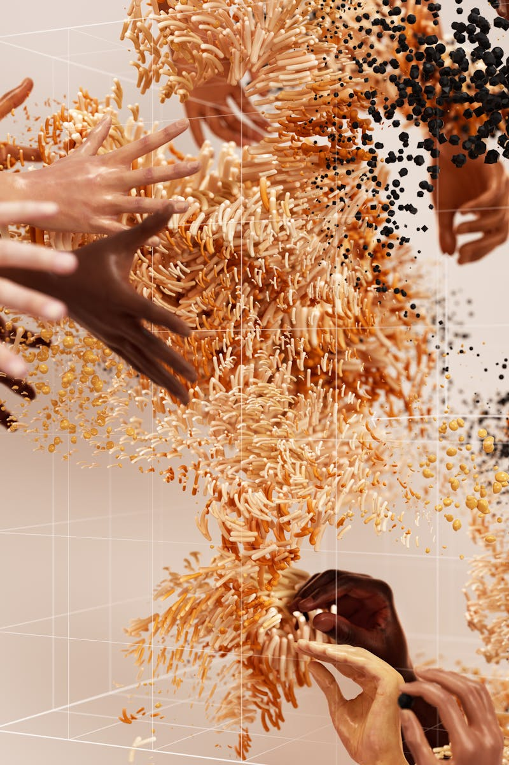
The Essence of Science
01
Science thrives on curiosity, inquiry, and evidence-based conclusions, fostering innovation and societal advancement. It is the backbone of human progress.
Maintaining integrity in scientific conduct ensures reliability, fostering trust among scientists and the public alike.
Scientometrics- The science of measuring and analysing scientific works, especially by way of analysing the publications and citations within them.
Eugene Garfeild- Founder of Institute for Scientific Information (ISI) which is heavily used for scientometric analysis.
Scientific Citation Index (SCI) was originally produced by ISI and created by Garfeild in 1960, which is now owned by Thomson Reuters. It is a citation index that covers scientific journal literature.

Slide 4
Understanding Scientific Conduct
Scientific conduct encompasses ethical guidelines and best practices to ensure valid research. Researchers must adhere to honesty, objectivity, and accountability, which guard against biases and ensure the integrity of the research process. Effective peer review and collaboration promote transparency and validation of research findings, enhancing the credibility of scientific work. By adhering to these principles, scientists contribute to a culture of excellence within the academic community.

Slide 5
Concept of Misconduct
Scientific misconduct is the violation of the standard codes of scholarly conduct and ethical behavior in the publication of professional scientific research.
Scientific misconduct includes fabrication, falsification, and plagiarism - actions that compromise the integrity of research.
Fabrication involves making up data, while falsification changes or omits data to mislead the scientific community.

Slide 6
Concept of Misconduct
Plagiarism
Plagiarism: Copying someone else’s intellectual property (information or ideas) as own achievement without giving the actual source. It is the most frequent type of qualitative misconduct and major breach of ethics.
Direct Plagiarism- Exactly copying someone else’s work, without giving them citations.
Self Plagiarism- Copying own published work.
Mosaic Plagiarism- Copying paragraph from different sources and not citing it.
Accidental Plagiarism- By mistake citations not done or wrongly done.

Slide 7
Consequences
End to career as a researcher.
Dismissal from faculty.
Rejection of research grants.
Blacklisted (e.g. reputed organizations refuse to hire, funding sources refuse to sponsor, journals refuse to publish research papers).
Recognizing and addressing misconduct is crucial for maintaining public trust in science and its practitioners.
Misconduct can lead to devastating consequences, including retractions of published work and loss of funding for researchers involved.
Copyright infringement.
A satisfied customer

Slide 8
Sabotage
Sabotage involves disrupting or destroying another person’s work so that the other person cannot complete an academic activity successfully.
Not contributing adequately to a collaborative work.
Withholding information
Revealing confidential data
Disturbing the setup or calibration of equipment another person

Slide 9
Duplicate Submission/Publication
Practice of submitting the same study to two journals or publishing more or less the same study in two journals.
Redundant Publication/Salami Publication/Salami Slicing/Segmented Publication
This refers to the situation that one study is split into several parts and submitted to two or more journals.
Self-plagiarism is a form of redundant publication.
Focus on quality of the paper.

Slide 10
Measures to Maintain Research Ethics & Preventing Misconduct
Develop clear research plan.
Submit protocol to ethical review.
Prepare well with your research community.
Agree on authorship.
Follow the approved protocol.
Gain consent.
Involve the community.
Protect yourself, your team & your participants.
Regularly check your data.
Share your study report.
Follow publication ethics.
Use reference management software.(Zotero, End Note, Mendeley etc.)
Proper citation and full disclosure.
What new it contain.

Slide 11
Selective Reporting and Misrepresentation of data
It is an act of omitting data that doesn’t seem significant.
Choosing to under-report data.
Choosing data for an outcome based on random decisions or personal choices rather than including all collected data for a clear picture.
Reporting of honestly collected data in a deceptive manner that favours researcher outcomes
Suppression of relevant facts
Data fishing/data dredging-misuse of data analysis to find patterns in data that can be presented as statistically significant, thus dramatically increasing and understating the risk of false positives. E.g. creation of deceptive graphs and figures.
Manipulation of images.
Changing objectives or hypothesis to conform to the results.
Not distinguishing prespecified from post hoc analysis.
Failing to report protocol deviations.

Slide 12
Types of Bias
Publication Bias-negative results are not published. Or it is selected to be manipulated to improve overall findings.
Spin Bias-Communicates results in such a way that it reflects positive findings.
Citation Bias-Positive studies more cited.
Design Bias- e.g. leaving a particular population in demographics. If a population of people are omitted that could be affected by the study, the final outcome could be invalid.
Procedural bias- this frequently happens when the researcher is rushed for deadline, resources, funds or faulty equipment is used.
Outcome reporting bias.
Conclusion- Include everything that occurs in your research in transparent measures, whether you deem it important or insignificant.

Slide 13
Selective Reporting and Misrepresentation of data
Reasons of misrepresentation of data
Departmental publishing requirements.
Requirement for promotion.
Competitive pressure.
Institutional, regional, national recognition
Financial renumeration
Do not feel well equipped to publish data.
How to avoid it?
Provide unprocessed images. Or adjust the clarity that abide by the guidelines of the journal.
Crop within the acceptable limits.
Review the images used in support of data.

